Slide 1
Teams and Groups in Organizations
Name
Institution Affiliations
Course Title
Date

Slide 2
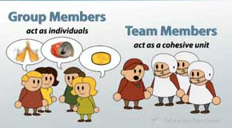
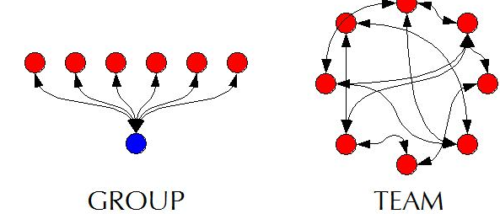
Difference between a team and a group
Team refers to a group of people who share a mutual purpose and several challenging goals and are mutually committed to the achievement of the goals.
The mutual commitment in a team creates a cooperative responsibility
The mutual commitment creates a strong bond and motivation for top performance.
A group refers to a collection of persons who synchronize their efforts towards interdependent accomplishments, and who may not necessarily be working in the same department.
Notes:
This slide addresses the ifference between a team and a group
In the business field, a team refers to a group of people who share a mutual purpose and several challenging goals and are mutually committed to the achievement of the goals. The mutual commitment in a team also creates a cooperative responsibility, which creates a strong bond and motivation for top performance. On the other hand, a group refers to a collection of persons who synchronize their efforts towards interdependent accomplishments, and who may not necessarily be working in the same department.

Slide 3

How groups and teams can be used effectively in an organization.
Teams and groups enhances effective realization of the purpose, values, goals, and objectives of an organization.
Making task accomplishment faster and effective than handling projects individually.
They encourage employees to cooperate in various tasks
Allowing employees to bond with one another
By improving the accountability of each member of the team or group, (Boies, et al, 2015).

Slide 4

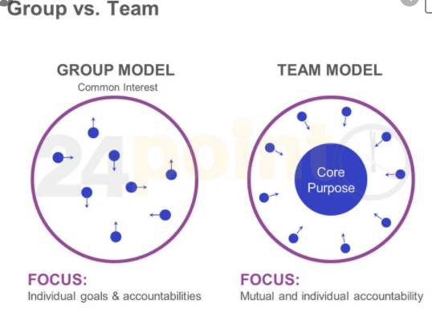
How groups and teams can be used effectively in an organization.
Can be used to increase cooperation of employees on a project.
Works together to equip skills among employees
Managing employees for the success of an organization
Notes:
Alternatively, teams and groups increase cooperation of employees on a project, which is a perfect opportunity for new employees and all other employees to learn from the experienced ones and also from one another. Working together in teams and groups is a great opportunity for equipping skills employees never had before. Generally, the effective management of employees for the success of an organization demands managers to put employees into groups and teams, which are more manageable and effective in accomplishing projects.

Slide 5
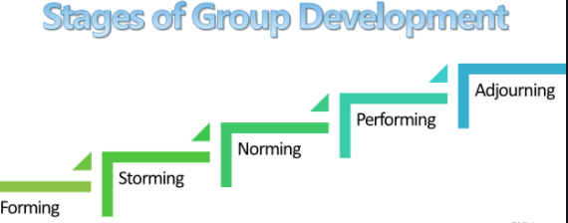
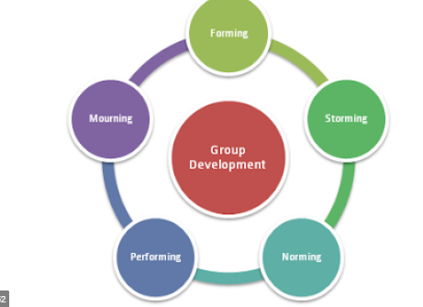
Phases of Group Development
Bruce Tuckman, a psychologist, developed five stages that teams go through in In the year 1965.
The five stages are:
Forming
storming
norming
Performing
adjourning
These stages begin at the time a group meets for the first time to the time the project ends.
Notes:
In the year 1965, Bruce Tuckman, a psychologist, developed five stages that teams go through. They consist of forming, storming, and norming, performing, and adjourning. These stages begin at the time a group meets for the first time to the time the project ends. The first phase, the forming stage, is more of an orientation stage where the team/group is introduced, the project goals discussed, the group members familiarize themselves with one another as roles and responsibilities begin to form. This stage is usually more focused on people more than work. In the second phase, the storming phase, the reality, and the weight of accomplishing the project at hand hit every group/team member. This stage may also be characterized by personality clashes.

Slide 6
Stages of group development
Forming stage, is more of an orientation stage where the team/group is introduced
Storming phase, the reality, and the weight of accomplishing the project at hand hit every group/team member
Norming phase. During norming, members begin to notice and appreciate the strengths of one another
Performing phase, the groups are confident and motivated to complete the project.
Adjourning phase, occurs once the project ends. This is where the team is disbanded
Notes:
This slides highlights 5 Phasesof development
Forming
storming
norming
Performing
adjourning

Slide 7
Strategies and practice for building and maintaining team performance
There are several strategies and practices which must be put in place.
This includes:
Proper definition of
Roles
Responsibilities
Notes:
In Both teams and groups, a proper outline of roles as well as responsibilities is required. The first and most important practice is a proper definition of roles and responsibilities to avoid team conflicts that affect project success. Additionally, Everyone need to have clearing understanding of their role. Besides, within a group it is paramount to know responsibilities of each member. Understanding roles and responsibilities is the best way to avoid confusion in an organization. Duties are easily delegated with clear understanding of roles and responsibilities as individuals could focus on tasks at hand.

Slide 8
Strategies and practice for building and maintaining team performance
Effective and cultivate communication channels
Building up trust and respect for all in an organization
Notes:
For effective establishment and maintenance of team performance, there are several strategies and practices which must be put in place. communication channels should be set clear since communication is one of the key elements to team productivity

Slide 9
Strategies and practice for building and maintaining team performance
Embracing socialization among team members
Motivation
Organizing team process
Notes:
This slide is focusing on strategies and practice for building and maintaining team performance. Some of these strategies are Organizing team process
Embracing socialization among team members and Motivation.
The development of team performance strategies and practices ensures that a team smoothly goes through the phases of group development. For instance, with proper communication strategies, the conflicts experienced in the storming stage can be effectively solved. Since the team members have been provided with a good working environment, they perform well, hence they go through the performing stage successfully. Generally, the strategies and practices for building and maintaining team performance ensure that the team becomes more efficient and productive. Team process is organized to provide employees with guidelines and logistics on how to spend time in doing what benefits the organization.

Slide 10
References
Boies, K., Fiset, J., & Gill, H. (2015). Communication and trust are key: Unlocking the relationship between leadership and team performance and creativity. The Leadership Quarterly, 26(6), 1080-1094.
Black, S., Gardner, D. G., Pierce, J. L., & Steers, R. (2019). Team Development Over Time. Organizational Behavior.
Singh, S. K., Burgess, T. F., Heap, J., Almatrooshi, B., & Farouk, S. (2016). Determinants of organizational performance: a proposed framework. International Journal of Productivity and Performance Management.

